Slide 1
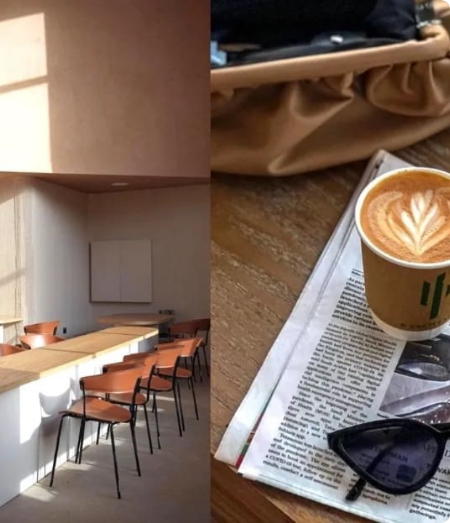
CM
Café Muse ME LLC
Sectioned case study + investment presentation
Financial model, investment memo and fundraising outcome for an anonymized café-licensing expansion.
$1.0M
20%
$400K
10%
initial target raise
initial equity target
final capital raised
final equity sold
Prepared as a portfolio-safe version using fictionalized names and anonymized information.

Slide 2
CM
Four-part structure
The first three sections explain the engagement and outcome. The fourth section contains the reconstructed investment presentation itself.
01
Introduction & disclosure
What is anonymized, what is fictionalized, and how to read the materials.
02
What we were trying to do
Build a model and investor memo to support a capital raise.
03
Results
Compare original target with final transaction and business outcome.
04
Investment presentation
Investor-facing deck based on the original memo and model outputs.
01 — Introduction & disclosure
02

Slide 3
CM
01
Introduction & disclosure
Scope, anonymization and how the reconstructed materials should be interpreted.
Café Muse ME LLC — case study deck

Slide 4
01
INTRODUCTION & DISCLOSURE
CM
Portfolio-safe version of a historical engagement
The deck deliberately separates what was part of the client work from what has been reconstructed for presentation.
Anonymized
Fictionalized
Not current forecasts
Financial information has been prepared for public presentation. Client-identifying details have been removed or generalized.
Company, brand and location identifiers are presented under fictional names to protect the original client.
The projections reflect the original modeling framework and should not be interpreted as current investment advice or live forecasts.
Working principle
Preserve the mechanics and decision logic of the original work while protecting confidential client information.
01 — Introduction & disclosure
04

Slide 5
01
INTRODUCTION & DISCLOSURE
CM
What was actually produced
The engagement created both the analytical model and the investor-facing narrative.
Financial model
Investment memo
Investor deck
Negotiation support
Core deliverables
1
36-month monthly financial model for a multi-country café-licensing expansion
2
Revenue, cash flow and deferred-revenue schedules tied to each planned outlet
3
Valuation and IRR sensitivity analysis for the proposed raise
4
Investment memo and presentation translating the model into investor language
01 — Introduction & disclosure
05

Slide 6
CM
02
What we were trying to do
Create an investor-ready financial model, investment memo and presentation to support a capital raise.
Café Muse ME LLC — case study deck

Slide 7
02
WHAT WE WERE TRYING TO DO
CM
Translate one proven café into a fundable expansion case
The business had an attractive licensing idea, but investors needed a structured view of scale, timing and risk.
Starting point
Target output
One proven location, regional licensing rights, and a proposed plan to scale through country-level operators.
A model-backed memo and presentation that made the fundraising ask explainable, negotiable and auditable.
Question for investors
Investor materials needed to show
Can the model generate enough cash, EBITDA and exit value to justify the requested capital?
Business model, opening plan, economics, deal structure, risks and exit options.
02 — What we were trying to do
07

Slide 8
02
WHAT WE WERE TRYING TO DO
CM
Model architecture
The workbook linked operating assumptions to financial statements and investor returns.
Operating history
Saudi baseline + existing royalty data
Opening schedule
Stores, countries, dates and fee timing
Country curves
Sales baselines, growth and seasonality
Royalty engine
6% revenue share with monthly minimum
Deferred revenue
Cash collected vs revenue recognized
Financial statements
P&L, cash flow and balance sheet
Investor analysis
Valuation, equity and IRR sensitivities
02 — What we were trying to do
08

Slide 9
02
WHAT WE WERE TRYING TO DO
CM
Fundraising logic
The target raise had to connect to how an investor could exit after the business scaled.
$1.0M
20%
25%
Return framework
initial raise sought
equity offered
IRR benchmark
Capital invested
× equity acquired
× exit value
= investor return
The model tested whether year-three EBITDA and valuation multiples could support the proposed terms, instead of treating the equity ask as a standalone number.
02 — What we were trying to do
09

Slide 10
CM
03
Results
What was targeted, what was actually raised, and what happened after the cafés proved successful.
Café Muse ME LLC — case study deck

Slide 11
03
RESULTS AND TRANSACTION OUTCOME
CM
Target vs final transaction
The actual raise was smaller, but it was completed at a stronger implied valuation than the original proposal.
Original target
Final transaction
$1.0M
20%
$400K
10%
for
for
$5.0M implied post-money
$4.0M implied post-money
Interpretation
The final deal reduced dilution relative to the original 20% ask, while still bringing in external capital to support the next stage of expansion.
03 — Results and transaction outcome
11

Slide 12
03
RESULTS AND TRANSACTION OUTCOME
CM
What happened after the raise
The transaction supported expansion, and the proof points made the rights valuable to the original brand owner.
1
2
3
4
Model + memo completed
$400K raised
Three cafés opened
Rights repurchased
A single model-backed fundraising story was created.
10% equity sold to an investor.
The licensing concept gained operating proof points.
Three years after the raise, the original brand owner bought back the rights for its own expansion.
End result
Three years after the raise, the original brand owner purchased the rights after the cafés proved successful in the Middle East, allowing the owner to exit at a profit.
03 — Results and transaction outcome
12

Slide 13
03
RESULTS AND TRANSACTION OUTCOME
CM
What the project demonstrates
The work was valuable because it connected commercial ambition, accounting mechanics and investor economics.
Driver-based modeling
Country-specific revenue curves, staggered openings, and minimum royalty logic.
Accounting clarity
Upfront cash collections were separated from deferred revenue recognition.
Investor negotiation
Valuation and IRR sensitivities framed the capital raise as a range, not a fixed claim.
Communication
The model outputs became an investment memo and presentation suitable for investor conversations.
03 — Results and transaction outcome
13

Slide 14
CM
04
Investment presentation itself
Reconstructed investor presentation based on the anonymized memo and model outputs.
Café Muse ME LLC — case study deck

Slide 15
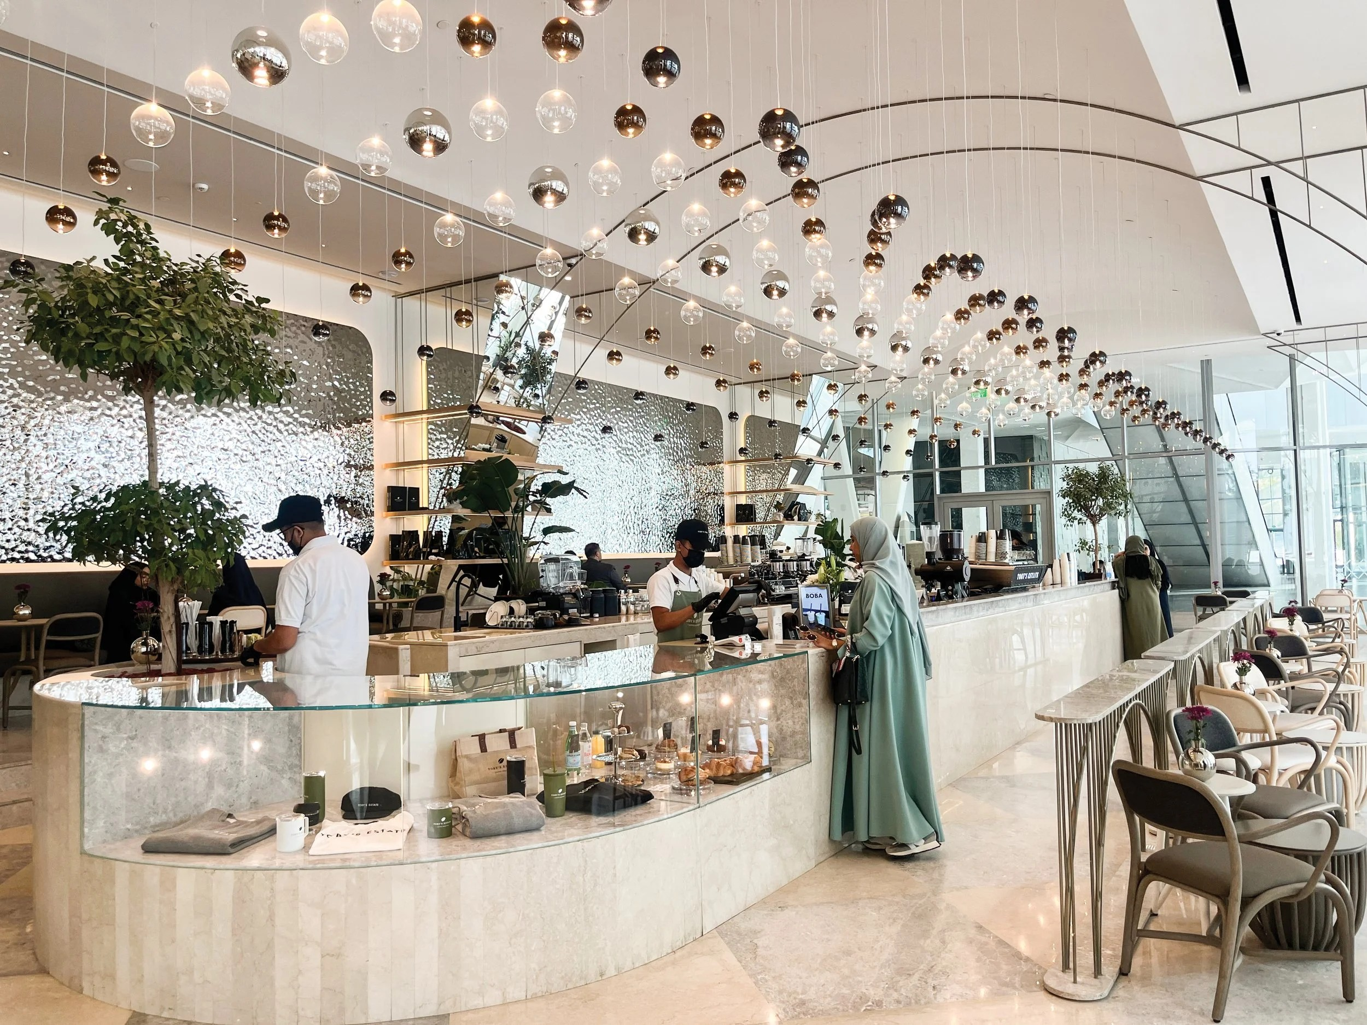
Café Muse ME LLC
Investment opportunity deck
Asset-light IP licensing model for premium café experiences across the Mediterranean and Gulf regions.
$1.0M raise
20% equity
10-year licenses

Slide 16
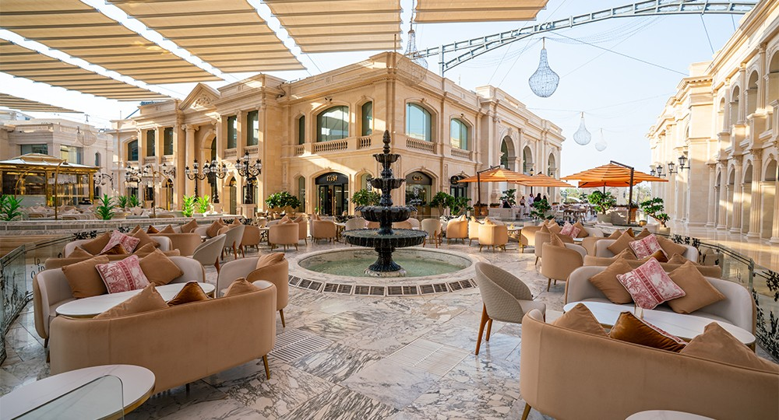
The investment thesis
A global lifestyle brand applied to cafés through an asset-light licensing structure.
WHY IT MATTERS
Café Muse ME LLC licenses the Café MUSE brand to experienced food & beverage operators, monetizing brand/IP without operating each café directly.
STRATEGIC LOGIC
The model is designed to scale through country-level operators, premium locations, upfront fees, and monthly royalty income tied to café revenue.
130M+
6%
$10K
stated monthly brand reach
royalty on café revenue
minimum monthly fee

Slide 17
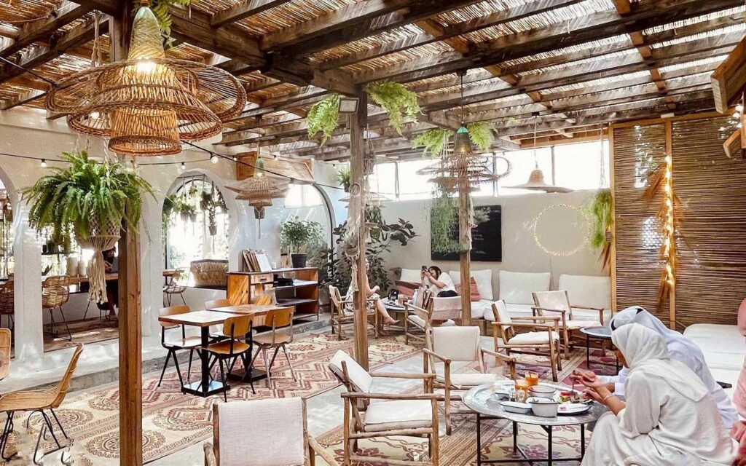
Premium café demand meets lifestyle branding
The concept positions cafés as social, retail, fashion and hospitality destinations.
POSITIONING
French art de vivre, fashion credentials and premium café ambience create a differentiated experience for operators and landlords.
TARGET GEOGRAPHIES
Mediterranean and Gulf markets with café culture, tourism flows and appetite for premium lifestyle concepts.
35
65M+
digital platforms
social reach

Slide 18
Business model: license the brand, not the operations
Café Muse retains IP economics while operators run the cafés.
Café MUSE IP
Country operator
Licensed cafés
Café Muse ME
Lifestyle brand, concept and standards
Selected F&B partner with local execution capability
Premium outlets in target locations
Royalties + deferred licensing fees
One-time fee
6% revenue share
$10K floor
10-year term
received upfront; recognized over 10 years
monthly royalty from each café
minimum monthly license payment
long-term operator agreements

Slide 19
Expansion roadmap: 10 cafés by mid-2026
The plan builds from Saudi Arabia into Qatar, UAE, Kuwait, Turkey, Morocco and Egypt.
2023
2024
2025
2026
Riyadh
Jeddah • Doha • Dubai
Abu Dhabi • DXB Airport • Kuwait City • Istanbul
Marrakech • Cairo
Saudi Arabia
Saudi Arabia, Qatar, UAE
UAE, Kuwait, Turkey
Morocco, Egypt
10
$3.25M
$2.22M
licensed outlets planned
initial one-time fees
total royalties through 2026

Slide 20
Revenue engine: upfront cash + recurring royalties
The model separates cash received from revenue recognized over the license period.
ACCOUNTING LOGIC
The upfront fee strengthens cash generation immediately but is recognized as deferred revenue over the 10-year agreement.
OPERATOR ALIGNMENT
The 6% monthly revenue share aligns Café Muse ME with the operator’s performance, while the minimum royalty protects baseline economics.
Cash first
Revenue over time
Performance-linked

Slide 21
Financial outlook: scaling into high margin profitability
Forecast shows transition from early operating loss to 60% EBITDA margin by year three.
$1.47M
$880K
60%
$3.99M
Dec-26 total revenue
Dec-26 EBITDA
Dec-26 EBITDA margin
Dec-26 ending cash

Slide 22
Cash flow is the core financial story
Upfront opening fees produce surplus cash even as accounting revenue is smoothed over time.
CASH CONVERSION LEVERS
Opening fees from new cafés: $950K in 2024, $1.1M in 2025 and $800K in 2026.
Operating cash flow turns positive in 2025, rising from -$98K in 2024 to $579K in 2026.
Deferred revenue liability grows alongside upfront licensing cash, reflecting recognition over the term.

Slide 23
Deal structure: $1M for 20% equity
The proposed investment targets expansion, licensing capabilities and operating infrastructure.
$1.0M
20%
25%
capital raise
equity offered
IRR benchmark
USE OF FUNDS
Expand into new markets, acquire additional IP rights, strengthen the licensing framework, and fund legal, marketing and administrative capabilities.
LIQUIDITY OPTIONS
Potential buyback at year three, delayed income arrangement, sale to another investor, later investment round, or retention for future growth.

Slide 24
Key risks and mitigants
Execution depends on operator quality, IP protection, market acceptance and economic resilience.
1
Market adoption
Use Saudi proof of concept, pilot programs and market-specific tailoring.
2
IP protection
Secure trademarks, patents where applicable and strict operator contracts.
3
Economic cycles
Diversify geographies and focus on resilient high-end demand.
4
Operator execution
Rigorous due diligence, training, support and quality audits.

Slide 25
A scalable lifestyle café platform
Café Muse ME LLC combines brand/IP monetization, operator-led execution and premium market positioning to build a licensing platform with attractive cash generation.
Next step: validate operator pipeline, licensing agreements, IP rights and model assumptions before investment decision.

